Slide 1
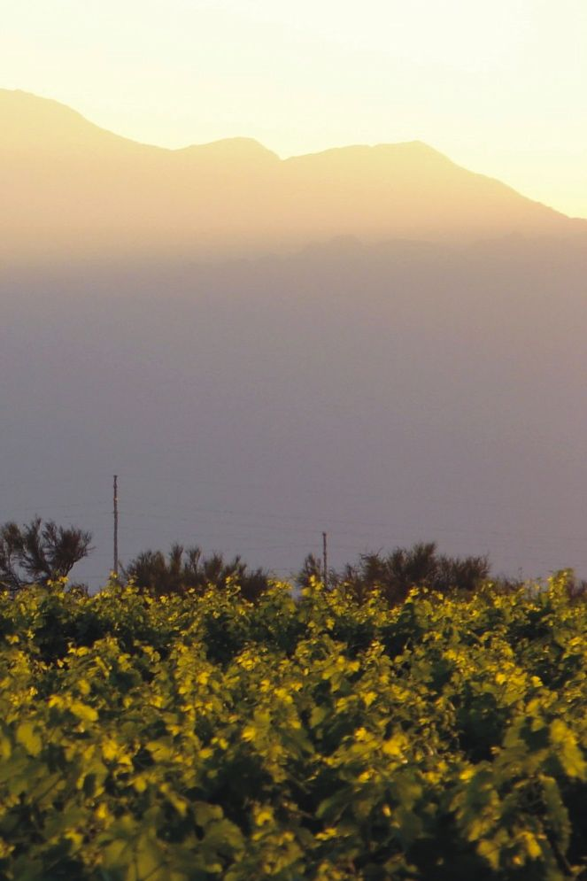
2013 TORRONTES
2013 TORRONTES
Powerful honeysuckle aromas,
melon and green apple, followed
by citrus flavors enhanced
by its crisp acidity.
Powerful honeysuckle aromas,
melon and green apple, followed
by citrus flavors enhanced
by its crisp acidity.
FAMATINA VALLEY - ARGENTINA
FAMATINA VALLEY - ARGENTINA
www.ecovalleyimports.com
www.ecovalleyimports.com
2013 TORRONTES
2013 TORRONTES
Powerful honeysuckle aromas,
melon and green apple, followed
by citrus flavors enhanced
by its crisp acidity.
Powerful honeysuckle aromas,
melon and green apple, followed
by citrus flavors enhanced
by its crisp acidity.
FAMATINA VALLEY - ARGENTINA
FAMATINA VALLEY - ARGENTINA
www.ecovalleyimports.com
www.ecovalleyimports.com

Slide 2
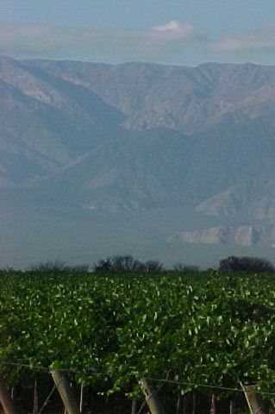
2013 SYRAH
2013 SYRAH
Complex bouquet of fresh and sour cherry aromas. The fresh fruits of this well-balanced Syrah that has a soft
and round finish.
Complex bouquet of fresh and sour cherry aromas. The fresh fruits of this well-balanced Syrah that has a soft
and round finish.
FAMATINA VALLEY - ARGENTINA
FAMATINA VALLEY - ARGENTINA
www.ecovalleyimports.com
www.ecovalleyimports.com
2013 SYRAH
2013 SYRAH
Complex bouquet of fresh and sour cherry aromas. The fresh fruits of this well-balanced Syrah that has a soft
and round finish.
Complex bouquet of fresh and sour cherry aromas. The fresh fruits of this well-balanced Syrah that has a soft
and round finish.
FAMATINA VALLEY - ARGENTINA
FAMATINA VALLEY - ARGENTINA
www.ecovalleyimports.com
www.ecovalleyimports.com

Slide 3
2013 CABERNET SAUVIGNON
2013 CABERNET SAUVIGNON
Intense and complex aromas
have hints of cherry, blackberry
and a touch of ripened
green pepper.
Intense and complex aromas
have hints of cherry, blackberry
and a touch of ripened
green pepper.
FAMATINA VALLEY - ARGENTINA
FAMATINA VALLEY - ARGENTINA
www.ecovalleyimports.com
www.ecovalleyimports.com
2013 CABERNET SAUVIGNON
2013 CABERNET SAUVIGNON
Intense and complex aromas
have hints of cherry, blackberry
and a touch of ripened
green pepper.
Intense and complex aromas
have hints of cherry, blackberry
and a touch of ripened
green pepper.
FAMATINA VALLEY - ARGENTINA
FAMATINA VALLEY - ARGENTINA
www.ecovalleyimports.com
www.ecovalleyimports.com

Slide 4
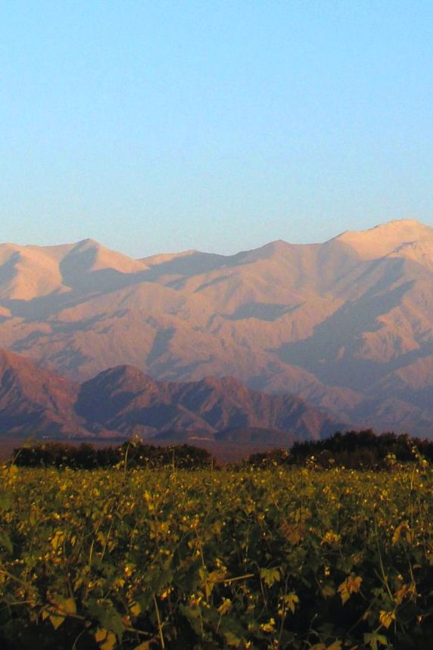
2013 MALBEC
2013 MALBEC
Aromas full of fruit with hints of
violets mingle with flavors of ripened plum and cherries accompanying
this wine's characteristically
smooth and sweet tannins.
Aromas full of fruit with hints of
violets mingle with flavors of ripened plum and cherries accompanying
this wine's characteristically
smooth and sweet tannins.
FAMATINA VALLEY - ARGENTINA
FAMATINA VALLEY - ARGENTINA
www.ecovalleyimports.com
www.ecovalleyimports.com
2013 MALBEC
2013 MALBEC
Aromas full of fruit with hints of
violets mingle with flavors of ripened plum and cherries accompanying
this wine's characteristically
smooth and sweet tannins.
Aromas full of fruit with hints of
violets mingle with flavors of ripened plum and cherries accompanying
this wine's characteristically
smooth and sweet tannins.
FAMATINA VALLEY - ARGENTINA
FAMATINA VALLEY - ARGENTINA
www.ecovalleyimports.com
www.ecovalleyimports.com

